Slide 1
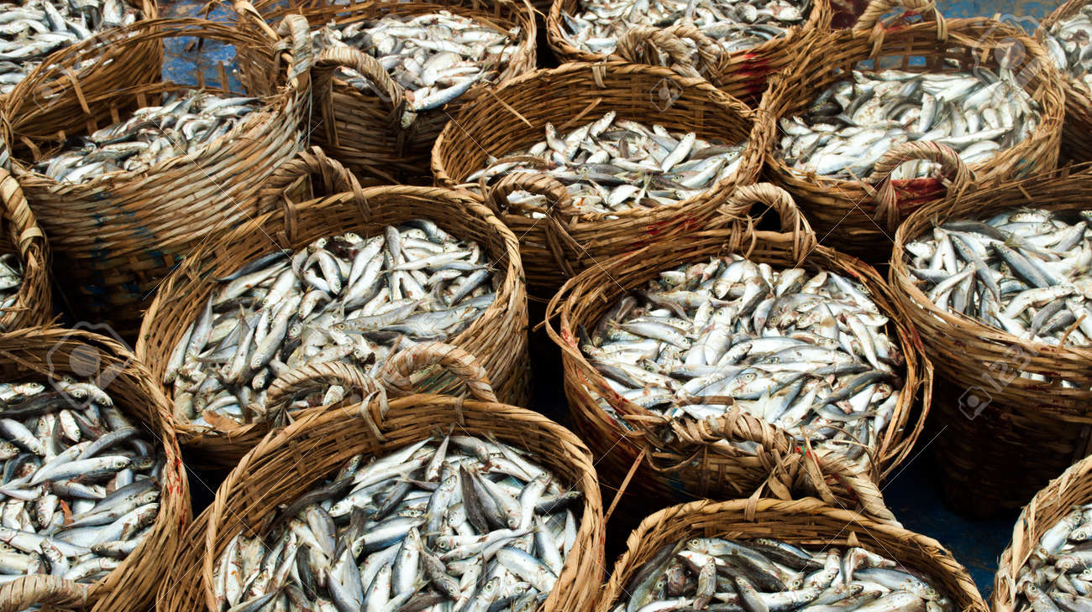
Quota Baskets
Analytical solution?

Slide 2
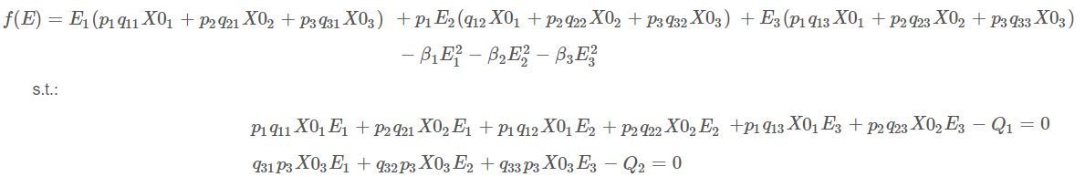
Case: 3 j, 3 i, 2 k
Subject to

Slide 3
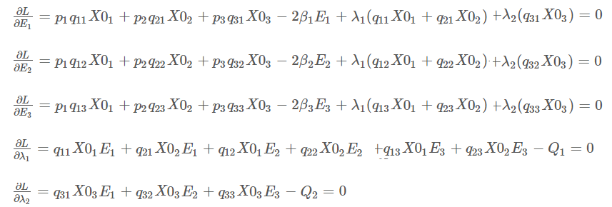
Case: 3 j, 3 i, 2 k
Derivates

Slide 4

Case: 3 j, 3 i, 2 k

Slide 5
Case: 3 j, 3 i, 2 k

Slide 6
Case: 3 j, 3 i, 2 k
Blue belongs to quota basket 1
Green belongs to quota basket 2
Tone of blues and greens indicate technology

Slide 7
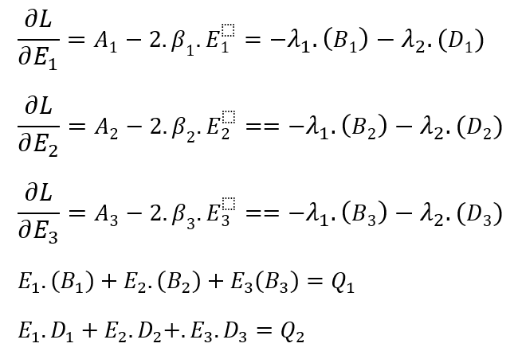
Case: 3 j, 3 i, 2 k
Our efforts are lonely thanks to power of 2!

Slide 8
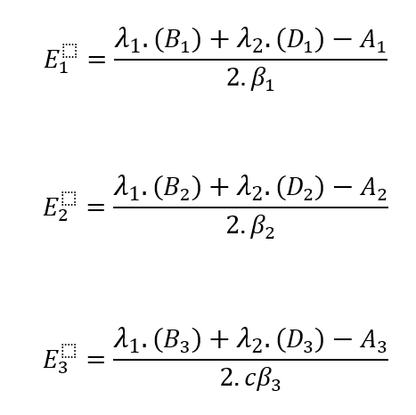
Case: 3 j, 3 i, 2 k
We clear our efforts…
…to replace them in the derivatives of lambda
We are left with 2 lambdas and a system of 2 equations

Slide 9
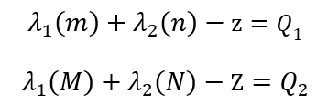
Case: 3 j, 3 i, 2 k
We are left with 2 lambdas and a system of 2 equations
After replacing our efforts, we should have something like this…

Slide 10
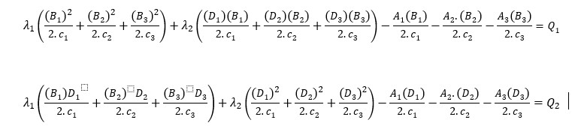
Case: 3 j, 3 i, 2 k
We regroup…

Slide 11
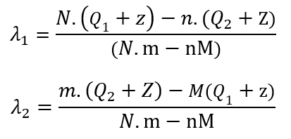
Case: 3 j, 3 i, 2 k

Slide 12
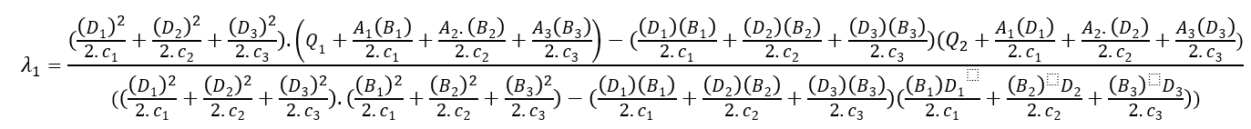
Case: 3 j, 3 i, 2 k

Slide 13
Case: 3 j, 3 i, 2 k
Better stay here…

Slide 14
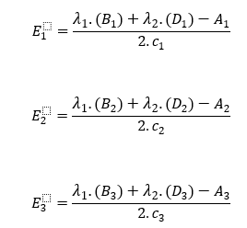
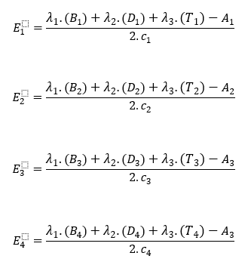
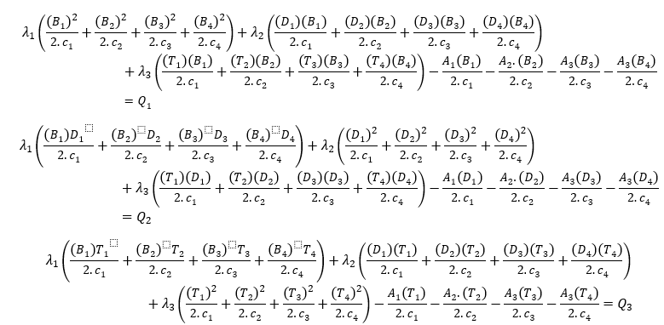
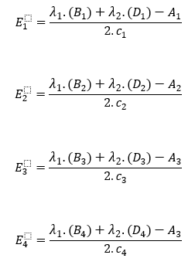
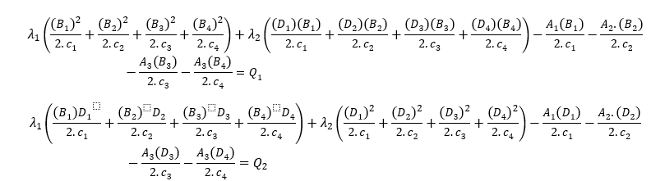

Slide 15
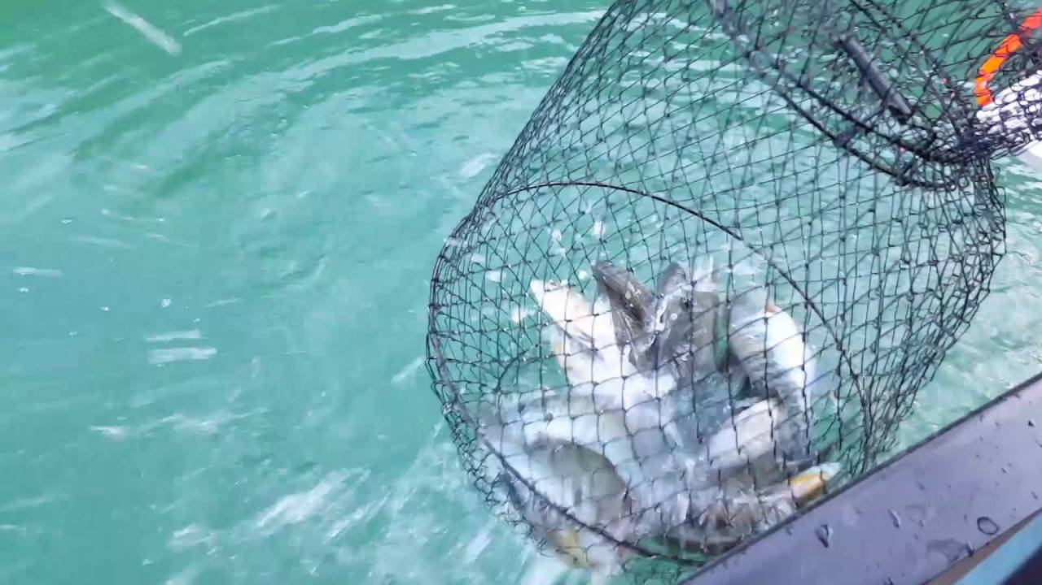
Thank you!

